Slide 1
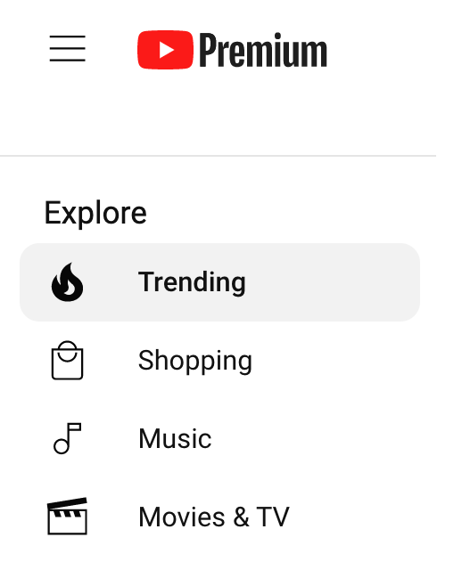
Youtube Trending Page Analysis
Group 3

Slide 2
Team Introductions
Amira Bendjama : Algerian Fulbrighter with a bachelor’s in computer science, and a master’s in networks and distributed systems. She is majoring in MSDS. Contributions : Initial idea of the project, Cleaning dataset, EDA, Machine learning models. | Thuy Hong Doan A graduate student in Data Science. She majored in a bachelor's degree in Information Systems Contributions: Cleaning dataset, EDA, supporting on predicting with machine learning models | Meznah Alsulami: A graduate student in Data Science. She majored in a bachelor's degree in Information Systems. Contributions: Exploratory Data Analysis Cleaning Dataset

Slide 3
Overview
Project Goal: predict the views of trending videos after 48 hours from publishing in the USA.
Data Source:
Youtube trending videos dataset from Kaggle.
The dataset includes the video title, channel title, publish time, tags, views, likes and dislikes, description, and comment count, category, trending date.
The project includes cleaning the datasets, Exploratory data analysis, and machine learning models, limitations.
This prediction is for: Content creators, Advertisers, YouTube platform.

Slide 4
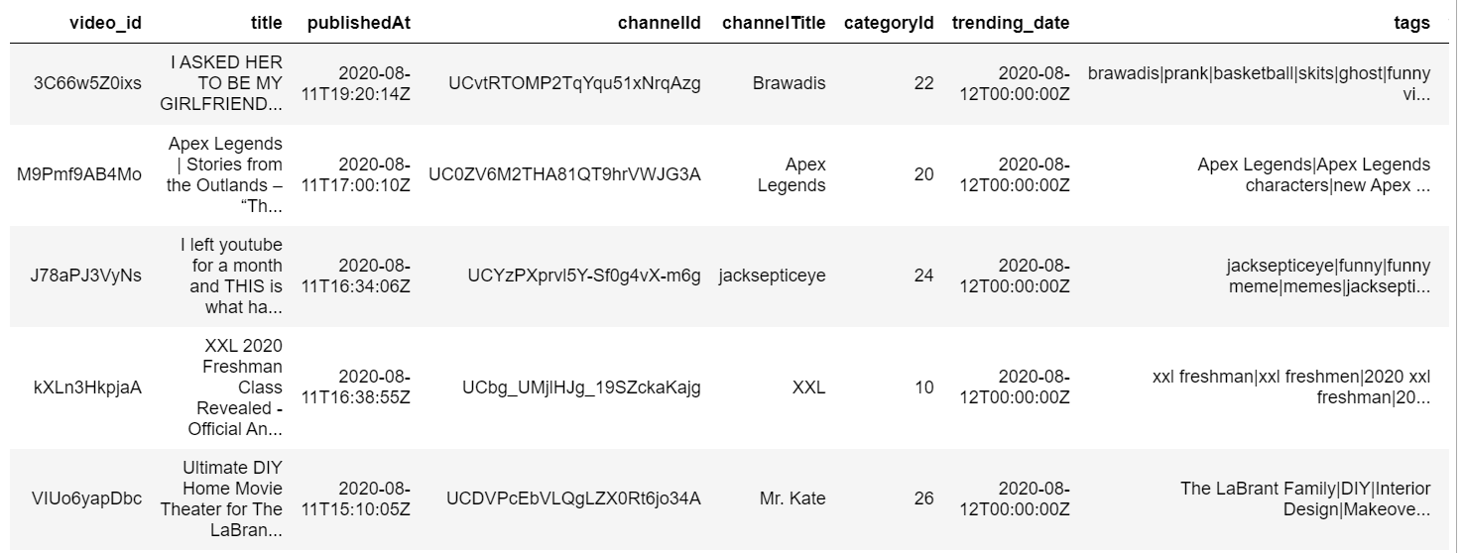
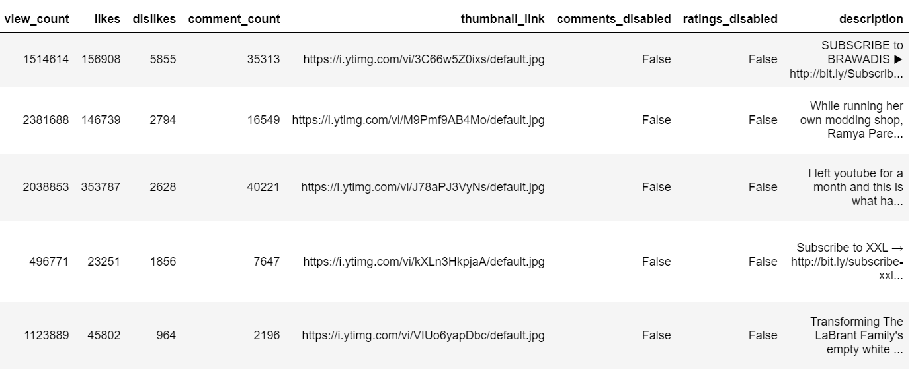
Youtube Trending Video Dataset
16 columns, 180k rows

Slide 5
Cleaning the dataset
Finding and deleting rows with a missing values, which were mainly in the Description column.
Replacing NaN in description with space.
Fixing the Tags column,by Replacing "[None]" with space, and splitting tags with '|' and convert list to one string.
Dropping duplicates rows in video id column.
Converting date columns 'publishedAt', 'trending_date' to datetime type.
Resetting indexing of the dataframe
Replace the category ID with the actual category name by creating a dictionary of category IDs and their corresponding names.
ِAfter cleaning the dataset ,the number of rows decreased to 34164 rows and to 13 columns

Slide 6
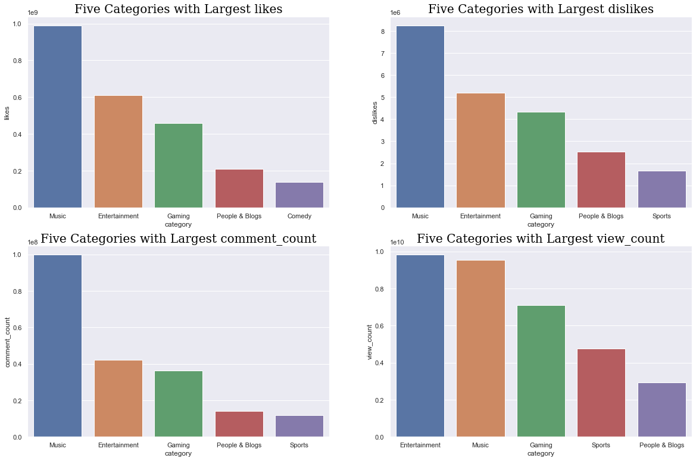
EDA: Finding top 5 categories
Top 5 categories with highest likes, dislikes, view counts, comment counts: Music, entertainment, gaming, sports, people & blog

Slide 7
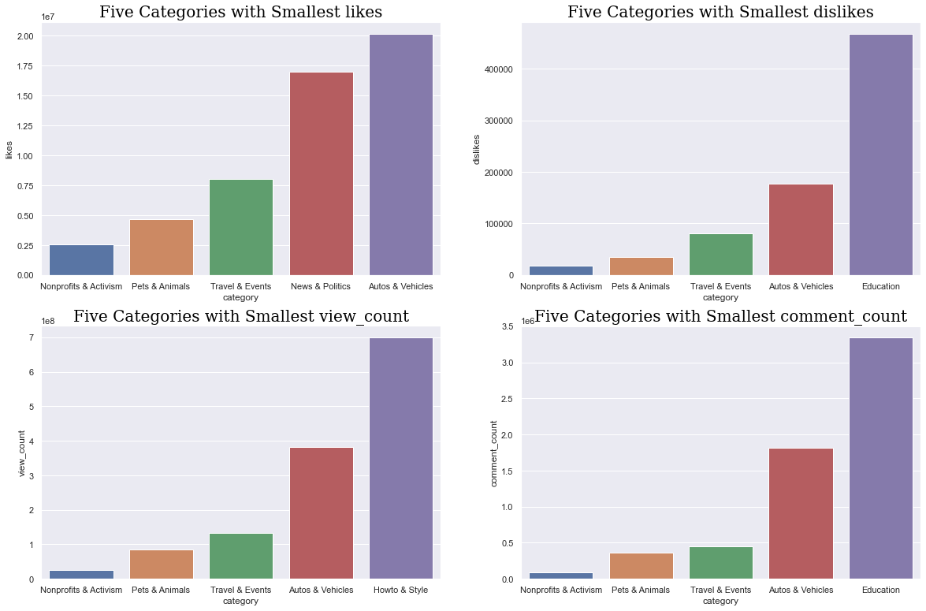
EDA: Finding bottom 5 categories
Top 5 categories with lowest likes, dislikes, view counts, comment counts: Nonprofit & activism, pet & animals, travel & events, news & politics, autos & vehicles

Slide 8
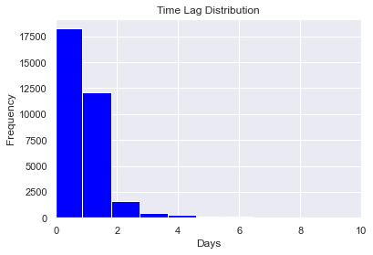
EDA: Finding time lag between publishing time and trending time
For a trending youtube video, it usually take 2 days (48 hours) from publishing to become a trending video
=> Keeping only videos that trended in the first 48 hours from posting
To gain more insights into the video's potential success and make more informed decisions.

Slide 9
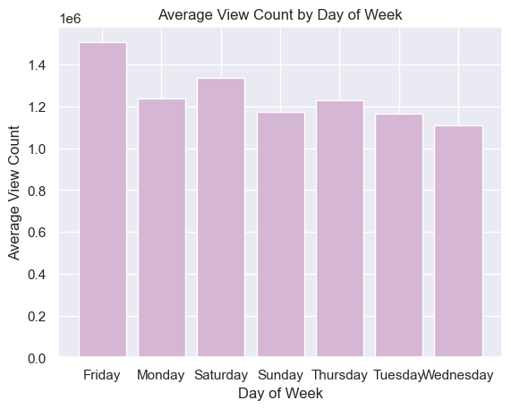
EDA: Which day of the week have highest average view count?
Average view count is highest on Friday.
Average view count is lowest on Wednesday

Slide 10
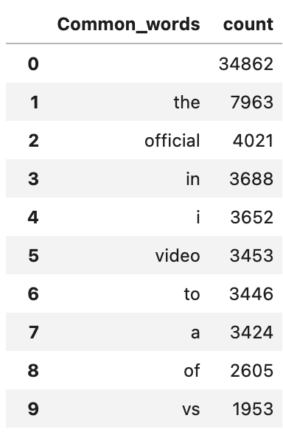
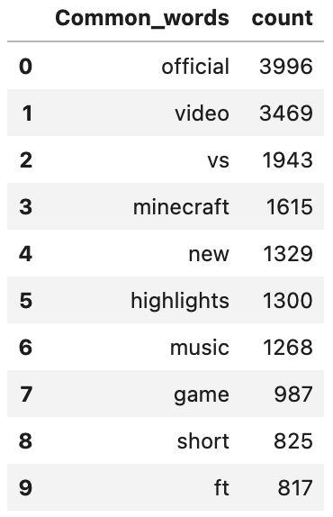
EDA: Finding the most used words in titles
Pre-process data
removing emojis, extra spaces, punctuations , non-alphabetic characters
Handle contractions (replace contractions with full words, i.e. you're >> you are)
Remove Stop words
Tokenization
Stemming
Lemmatization
Before
After

Slide 11
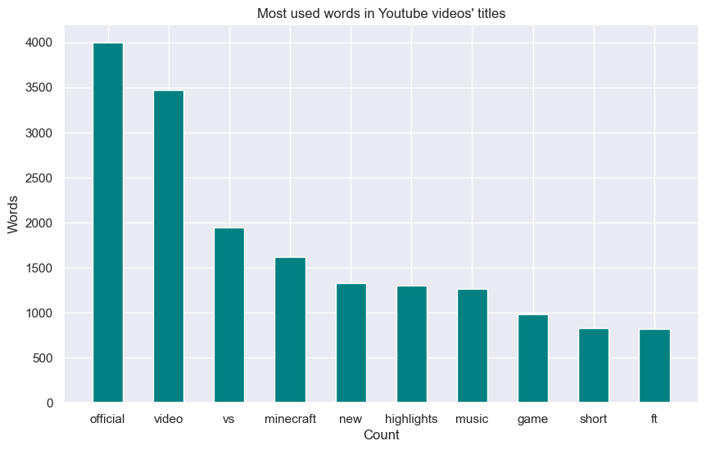
Most used words in youtube trending videos

Slide 12
Machine Learning Prediction Models
Cross-validation vs train test splitting
Features and target variable
Regression Models: Decision tree, Random forest, gradient boosting
Scoring metrics: R-squared , RMSE

Slide 13
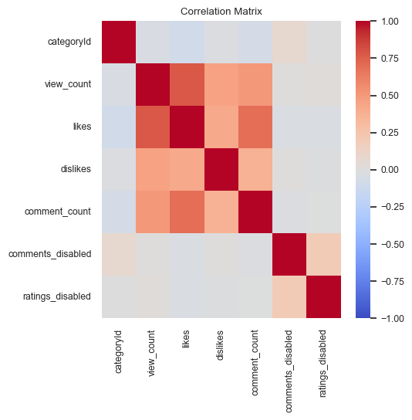
Features:
Feature selection : matrix correlation
Features : category, likes, dislikes,
comments, length of titles,
length of description, number of tags,
comment status, rating status,
ratio between views and likes/dislikes/comments,
ratio of likes to dislikes.
Target variable: view count

Slide 14
Models
Decision tree: A tree-like model that breaks down a dataset into smaller subsets by recursively selecting the best feature to split on.
Random forest: An ensemble learning algorithm that builds multiple decision trees and combines their predictions.
Gradient boosting: An ensemble learning algorithm that builds a sequence of decision trees, where each tree tries to correct the errors of the previous tree, and combines the predictions of all trees to make a final prediction.

Slide 15
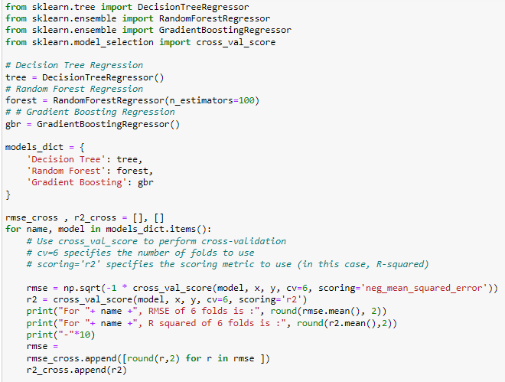
Cross-Validation : regression models

Slide 16
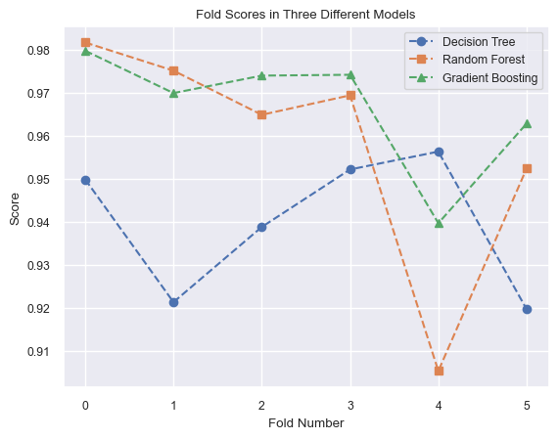
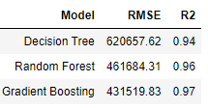
Decision tree, Random forest, Gradient Boosting
By implementing these 3 models, using
R-squared , RMSE metrics :

Slide 17
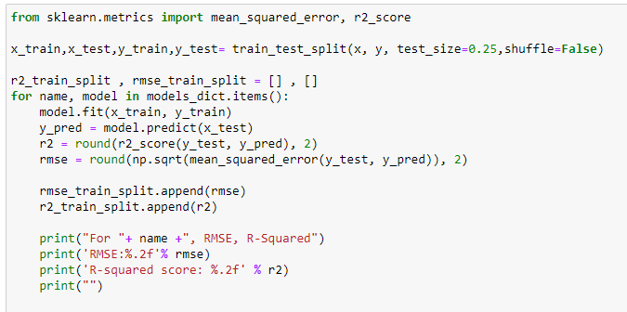
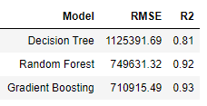
Train-test splitting : regression models

Slide 18
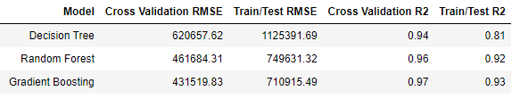
Cross-validation vs Train-test splitting:
Random forests and gradient boosting also tend to be more accurate than single decision trees but can be more computationally expensive to train.

Slide 19
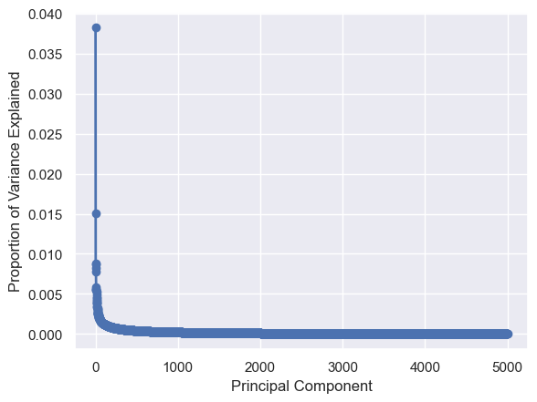
Challenges and limitations
Hardware limitation :
Running out of memory which it made it impossible to include other features such as titles and tags. Even after using PCA, and finding the optimal number for component which was 2316 instead 5000.

Slide 20
Challenges and limitations
Dataset limitation :
The dataset is limited to several months and only 200 videos per day, and hence it could add some bias on the predictions.
Missing duration column.
Model limitation :
Missing features: such as duration, titles, tags, thumbnails.

Slide 21


